Slide 1

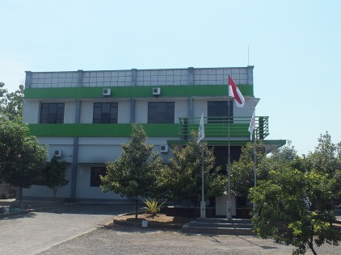
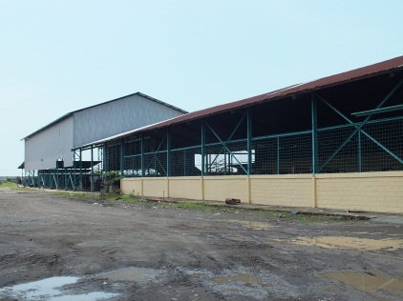
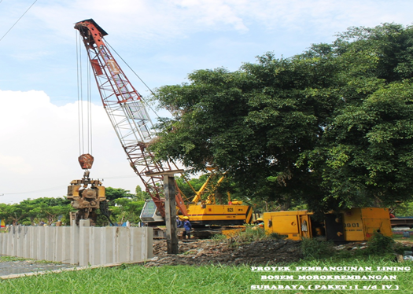

PT HASTA PRAJATAMA
GENERAL CONTRACTOR, PILING & SUPPLIER
Head Office & Workshop Address:
Branch Office Address:
Jalan Lingkar Timur No. 1 Kemiri, Sidoarjo
Jawa Timur, Indonesia
Telp. (031) 8956551 ; 8073893
Fax. (031) 8956550
Jalan Ciputat Raya No. 100 E
Kebayoran Lama, Jakarta Selatan
Indonesia
Telp. (021) 72895005
Fax. (021) 72895004
Website:
www.hastaprajatama.com
Email:
hastaprajatama.fabrikator@gmail.com
hastaprajatama@yahoo.com

Slide 2
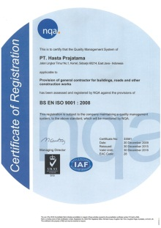
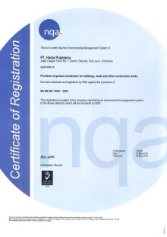
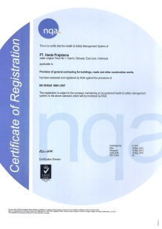
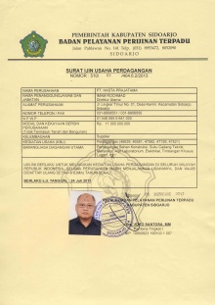
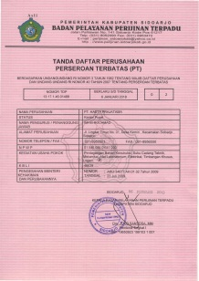
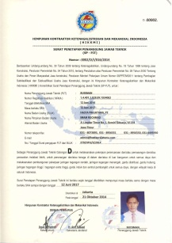
PT HASTA PRAJATAMA
GENERAL CONTRACTOR, PILING & SUPPLIER
Qualification:
Association Members:
Major Scale Company
GABPEKNAS
APKOMATEK
AKMI
HIKKMI
AKLI
Legality & Certificates:
Certify The Quality Management System
ISO 9001
Certify The Environmental Management System
ISO 14001
Certify The Health & Safety Management System
ISO 18001
Surat Ijin Usaha Perdagangan
Tanda Daftar Perusahaan
Perseroan Terbatas (PT)
Surat Penetapan
Penanggung Jawab Teknis

Slide 3
PT HASTA PRAJATAMA
GENERAL CONTRACTOR, PILING & SUPPLIER
Our Product:
DIVISION OF STEEL STRUCTURE FABRICATOR & ERECTION
Rafter Steel Structure
Steel Support of High Voltage Equipment
Tower Transmission
Beam & Colom Post for Substation
Gantry Girder
Warehouse Building Steel Structure
Equipment Part of Boiler Non Pressure Part:
Ducting System
Steel Stack
Bunker, Silo, etc.
Piping Line & Piping Support
Main Power Building Steel Structure
Boiler House
Turbine House
DIVISION OF CIVIL WORK
Road
Bridge
Pier / Jetty
Irrigation & Dam
Building
Electrical Building (Substation, Transmission etc.)
Factory & Warehouse
DIVISION OF PILING WORK & HEAVY EQUIPMENT
Piling Onshore & Offshore
Heavy Equipment Rent (Rent: Excavator, Loader, Bulldozer, Crawler Crane 25 tons up to 95 tons, etc.)

Slide 4
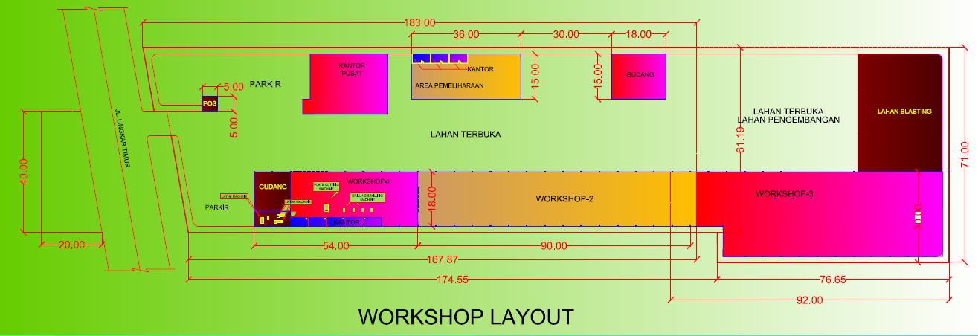
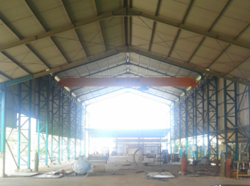
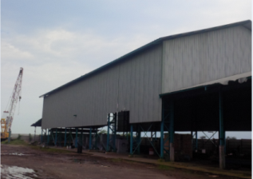

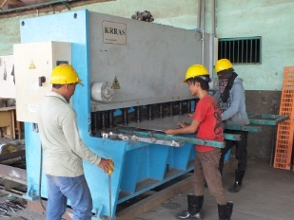
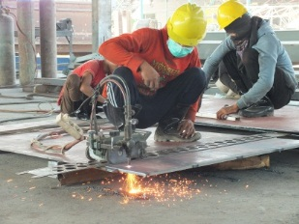
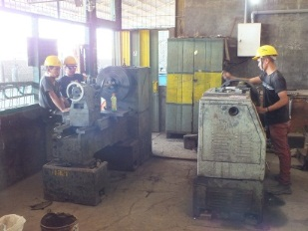
WORKSHOP LAYOUT
The Workshop area estimate is 2.0 Ha and fabrication work is able to do with capacity of 100 tons per month
Open areas used for the materials to finished fabrication work and ready to be delivered to Customer
The technicians doing fabrication work for the project execution in the workshop

Slide 5
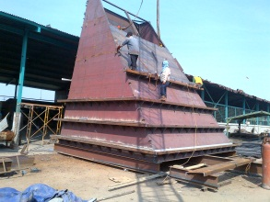
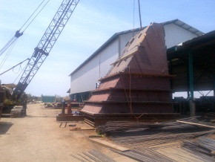
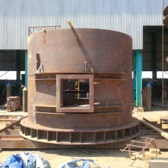
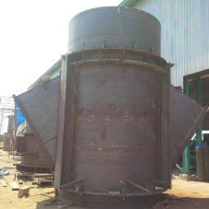
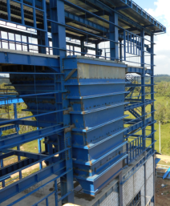
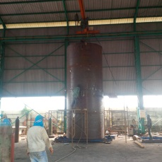
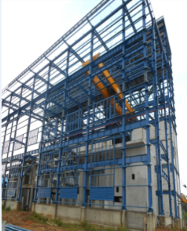
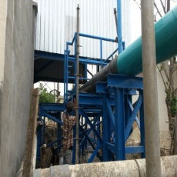
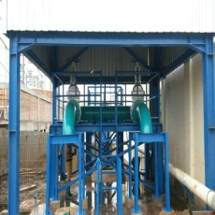
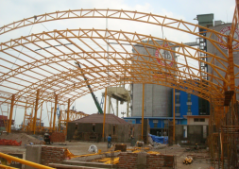
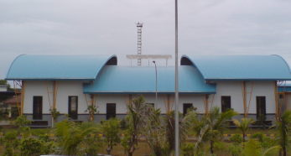
PROJECT EXCECUTION
DIVISION OF STEEL STRUCTURE FABRICATOR & ERECTION
Fabrication work, Supply material and Erection of Coal Bunker with capability to operate the boiler at its specified maximum output 16 hours for PLTU 2 x 7 MW Berau Kalimantan Timur
Fabrication work and supply material of Steel Stack with 3000 mm Diameter & 40 meter height for PLTU 2 x 7 MW Berau Kalimantan Timur
Fabrication work, Supply material and Erection of Main Power Building Turbine Steel Structure for PLTU 2 x 7 MW Berau Kalimantan Timur
Supply of Discharge Piping and Site Erection for Bunker Discharge at PJB UP Muara Karang
Fabrication work, Supply material and Erection of Palletizer Packing Plant Building for PT Semen Gresik

Slide 6
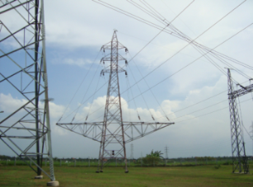
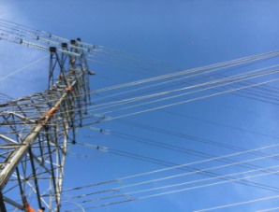
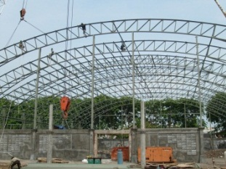
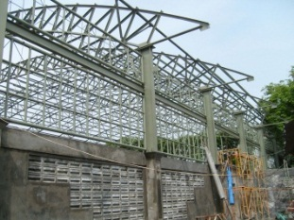
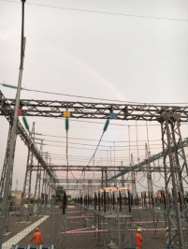
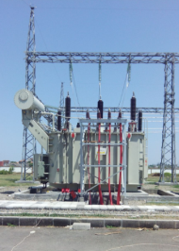
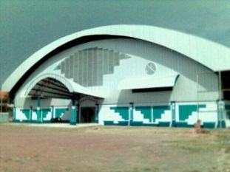
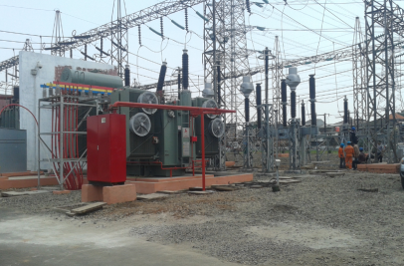
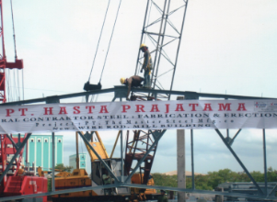
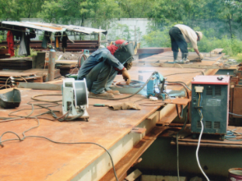
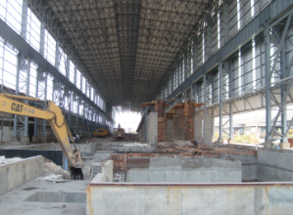
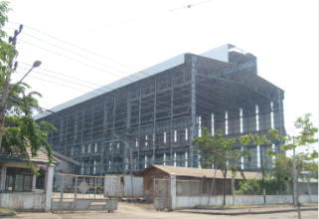
PROJECT EXCECUTION
DIVISION OF STEEL STRUCTURE FABRICATOR & ERECTION
Fabrication work and Erection of Transmission Tower
Fabrication work and Erection of Indoor Tennis Building
Colom post and Beam
Steel Structure Support for High Voltage Equipment
Fabrication work and Construction of Mill Building Steel Structure for PT Master Steel

Slide 7
EXPERIENCE LIST
DIVISION OF STEEL STRUCTURE FABRICATOR & ERECTION
No | PROJECT | CUSTOMER
1 | STEEL STRUCTURE SUPPORT HV EQUIPMENT OF GI 150 kV - ALAM SUTERA | PT PLN (PERSERO)
2 | STEEL STRUCTURE SUPPORT HV EQUIPMENT OF GI 150 kV - SAYUNG | PT PLN (PERSERO)
3 | STEEL STRUCTURE SUPPORT HV EQUIPMENT OF GI 150 kV - LIWA | PT PLN (PERSERO)
4 | STEEL STRUCTURE SUPPORT HV EQUIMENT OF GI 150 kV - SAMBELIA | PT PLN (PERSERO)
5 | CONSTRUCTION WORK EXPANSION FACTORY AT PT INDONESIA MATSUYA - PIER PASURUAN | PT XENODIA MANDIRI
6 | CONSTRUCTION WORK EXPANSION FACTORY AT MARUFUJI - NGORO INDUSTRY | PT XENODIA MANDIRI
7 | CONSTRUCTION WORK EXPANSION FACTORY AT DAIKEN PROJECT - PIER PASURUAN | PT XENODIA MANDIRI
8 | EXPANSION SANYO MEDICAL INDONESIA FACTORY - PIER PASURUAN | PT XENODIA MANDIRI
9 | EXPANSION FACTORY OF SHOFA GIKO - PIER PASURUAN | PT XENODIA MANDIRI
10 | EXPANSION FACTORY OF YAMAMORI - GEDANGAN SDA | PT XENODIA MANDIRI
11 | FABRICATION WORK & CONSTRUCTION SARI ROTI FACTORY - PIER PASURUAN | PT XENODIA MANDIRI
12 | FABRICATION WORK & CONSTRUCTION OF HOU-TECH FACTORY - PIER PASURUAN | PT XENODIA MANDIRI
13 | NANKAI BUILDING FACTORY - GRESIK | PT XENODIA MANDIRI
14 | FABRICATION WORK & CONSTRUCTION INDOOR TENNIS BUILDING - SIDOARJO | DINAS PU CIPTA KARYA & PERUMAHAN KAB. SIDOARJO
15 | FABRICATION WORK & CONSTRUCTION KING JIM WAREHOUSE - PIER PASURUAN | PT XENODIA MANDIRI
16 | PALLETIZER PACKING PLANT BUILDING - CIWANDA N CILEGON | PT SEMEN GRESIK
17 | FABRICATION WORK & CONSTRUCTION DAICHI KOUN FACTORY - PIER PASURUAN | PT XENODIA MANDIRI
18 | FABRICATION WORK & CONSTRUCTION MILL BUILDING - GRESIK | PT MASTER STEEL
19 | SUPPLY OF DISCHARGE PIPING & SITE ERECTION FOR BUNKER DISCHARGE - MUARA KARANG | PJB UP MUARA KARANG
20 | SUPPLY, FABRICATION & CONSTRUCTION PLTU 2 x 7 MW BERAU - KALTIM | PT PLN (PERSERO)

Slide 8
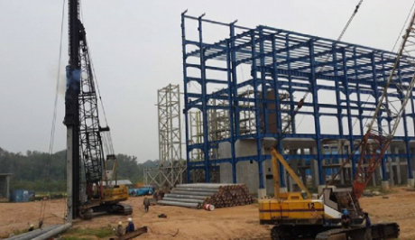
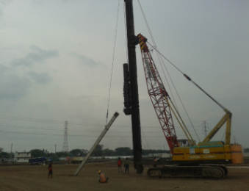
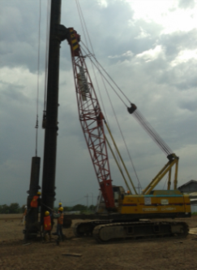
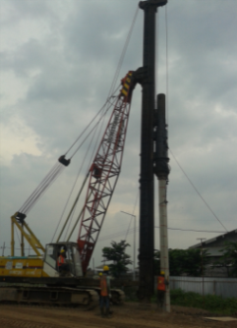
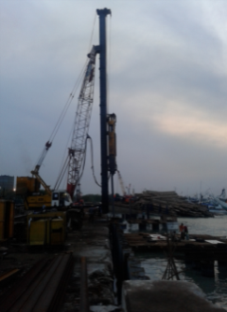
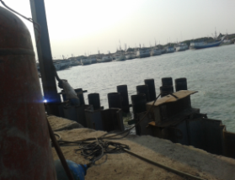
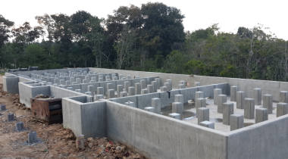
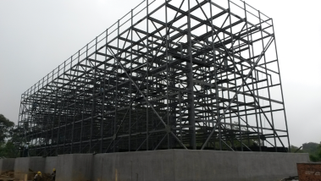
PROJECT EXCECUTION
DIVISION OF PILING WORK
Piling work of Factory Building with specified piling square 0.5m and 6 meter length for Cargil Factory Pasuruan
Piling work of Turbine Building with specified piling diameter 0.5m and 12 meter length for PLTU 2 x 7 MW Berau Kalimantan Timur
Piling work and steel sheet pile of Port Building at Pelabuhan Tanjung Mas Semarang
Piling work and steel structure of Cooling Tower at PLTU 2 x 7 MW Berau Kalimanta Timur

Slide 9
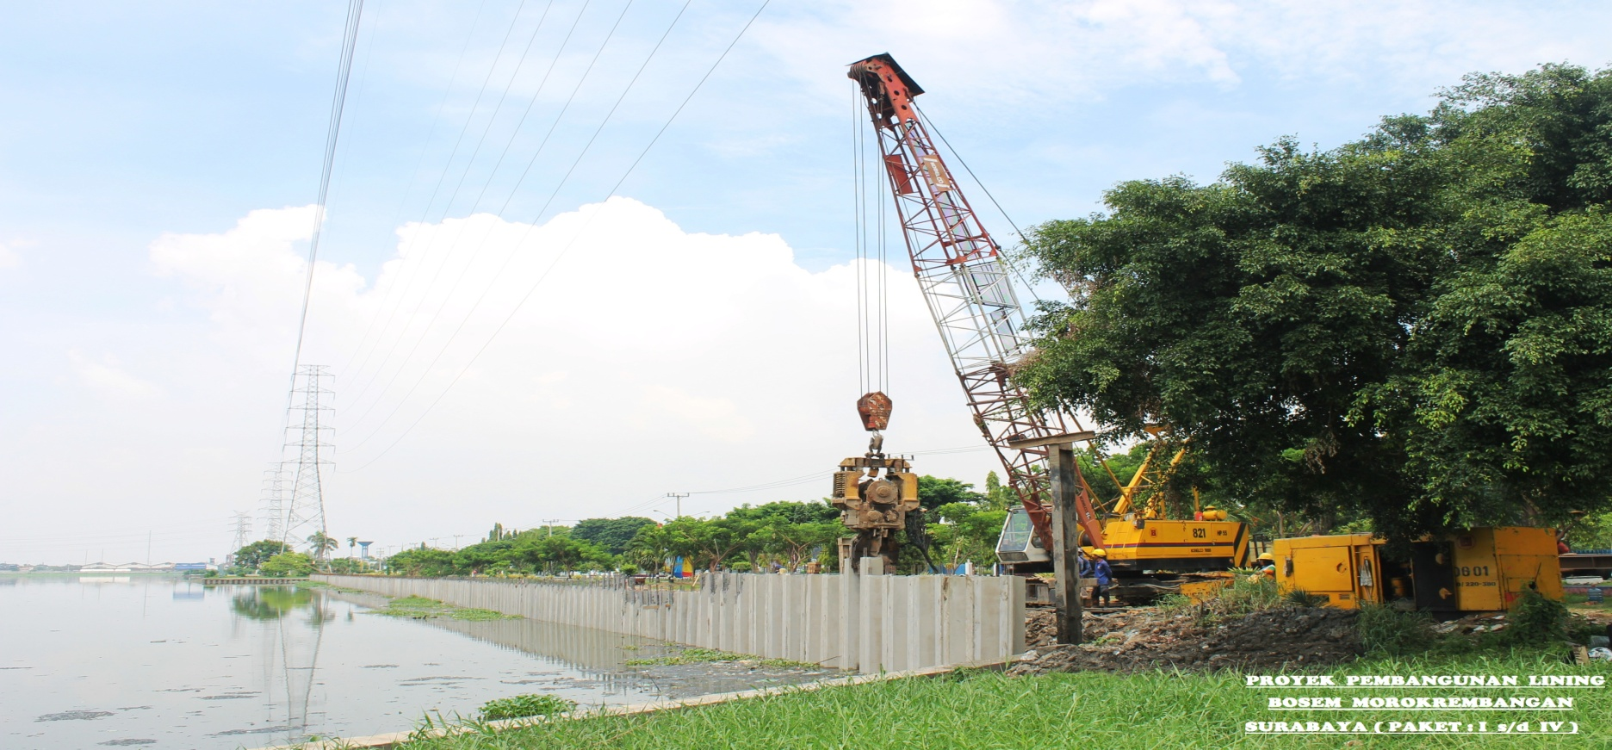
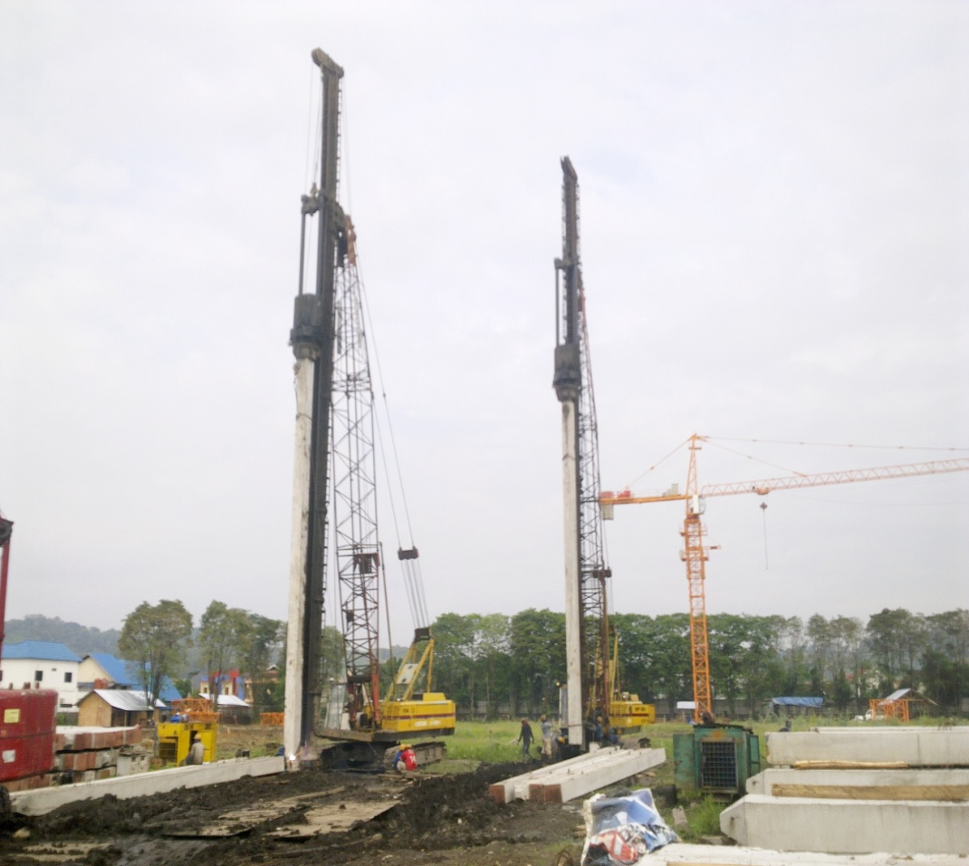
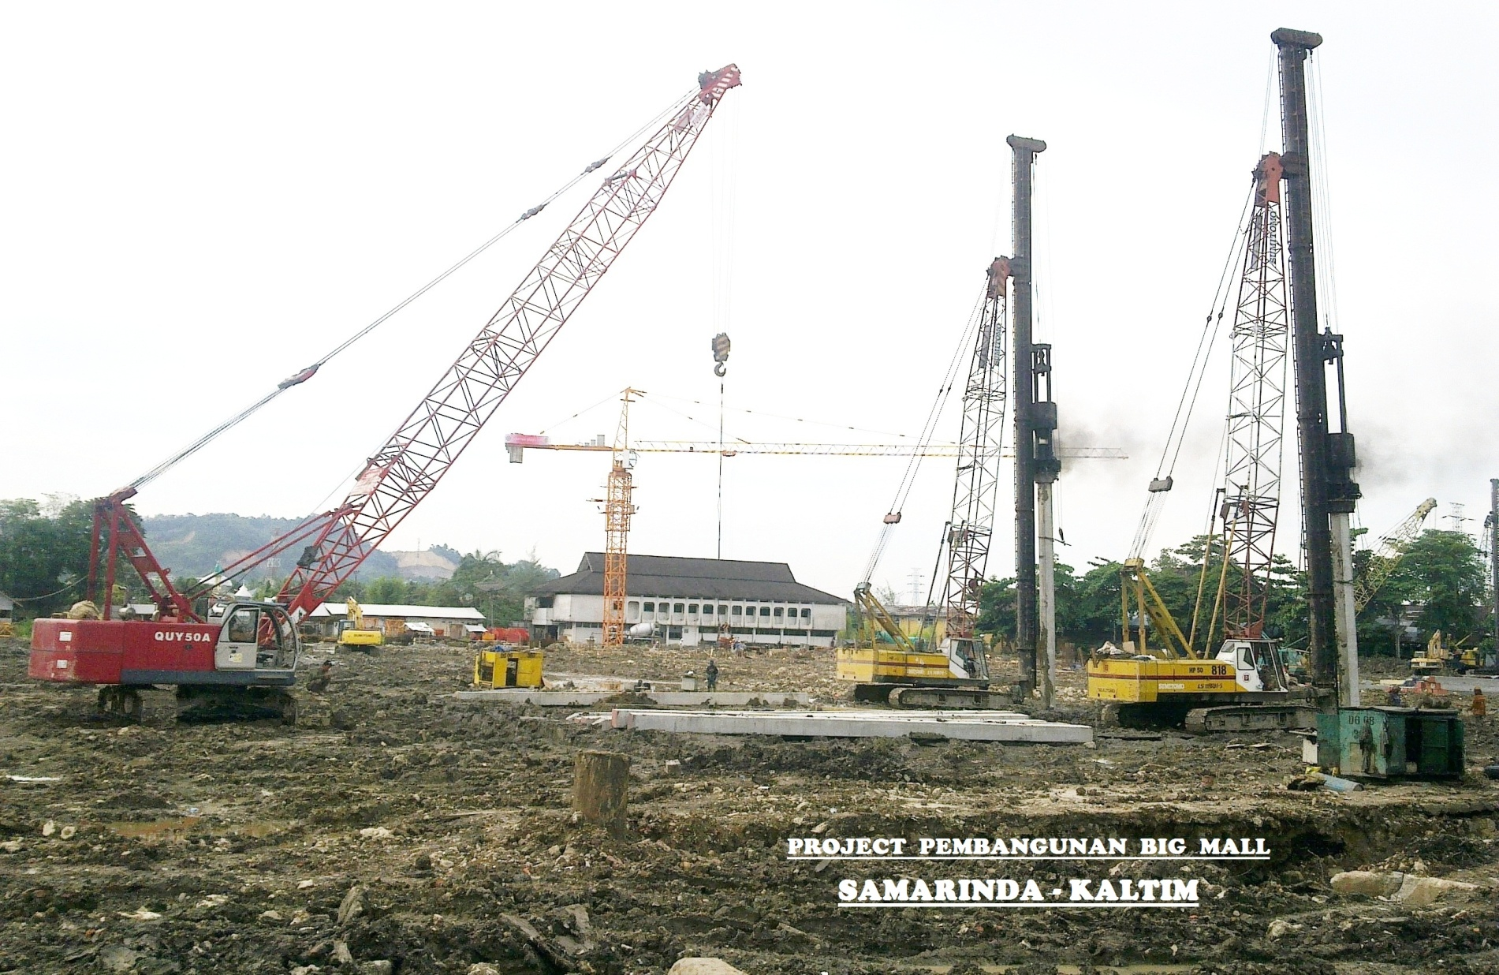
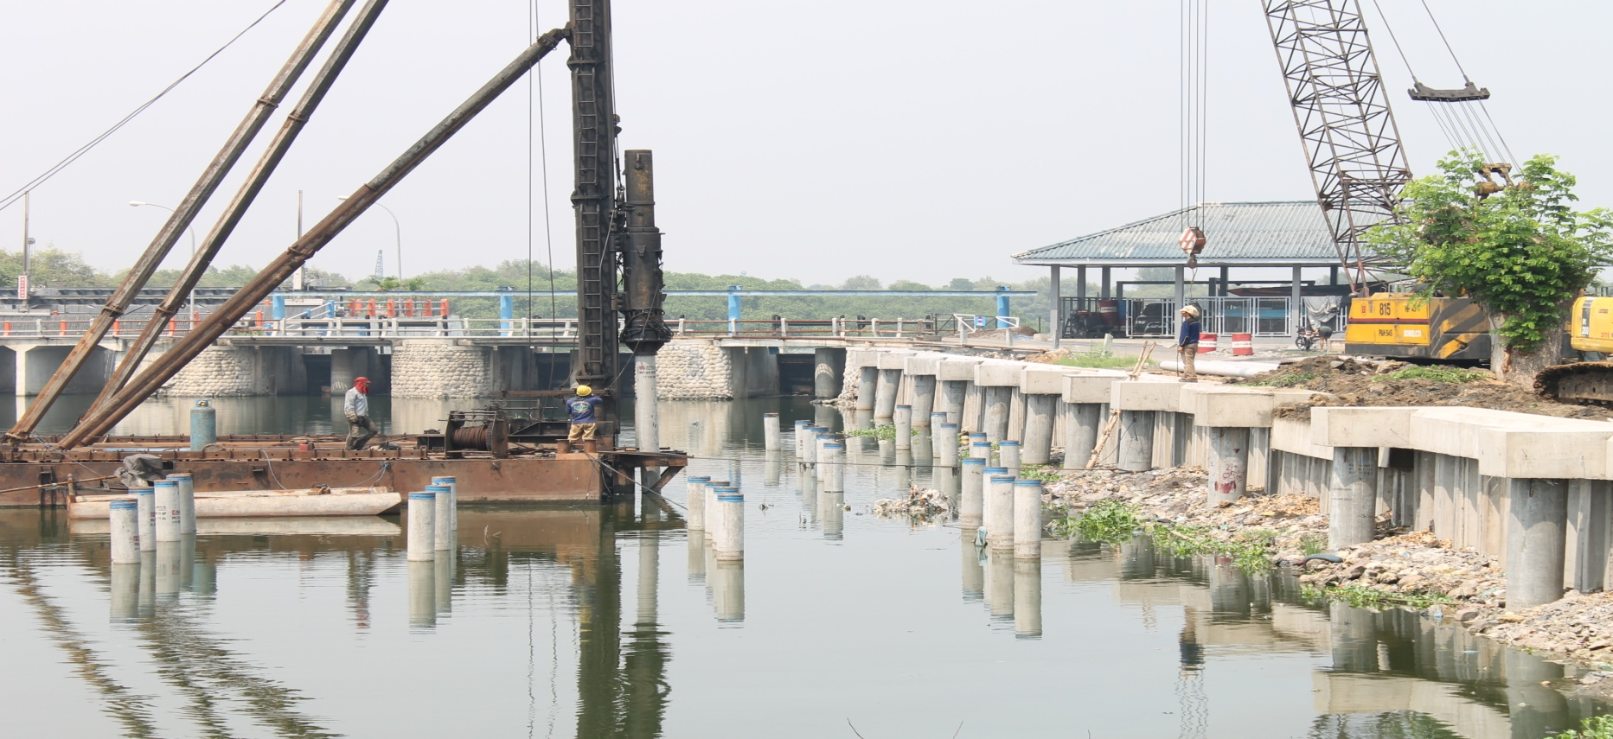





PROJECT EXCECUTION
DIVISION OF PILING WORK
Piling work of Big Mall Building at Samarinda Kalimantan Timur
Lining Bosem build at Morokrembangan Surabaya
Piling work of reclamation for “Pantai Amal Baru at Tarakan Kalimanta Timur
Piling work of Toll Road at Surabaya - Mojokerto

Slide 10
EXPERIENCE LIST
DIVISION OF PILING WORK
No | PROJECT | CUSTOMER
1 | Proyek Pemancangan Spun Pile Tol Surabaya Gempol (Porong-Gempol) | PT. PP DVO - Surabqya
2 | Proyek Pemancangan Spun Pile Bendung Gerak Sembayat | Waskita – Wika KSO Surabaya
3 | Proyek Pemancangan Spun Pile Apattement Marvell City | PT Adhi Karya - Surabaya
4 | Proyek Pemancangan CCSP Perkuatan Tebing Pemali, Brebes Jawa Tengah | PT Hutama Karya - Surabaya
5 | Proyek Pemancangan CCSP & PC Pile Penurapan Tana Lia, Tana Tidung | PT Wijaya Karya - Jakarta
6 | Proyek Pemancangan Spun Pile Penambahan Lajur Jalan Tol Surabaya - Gresik | Hutama Adya Tunggal KSO SBY
7 | Proyek Pemancangan Steel PileTol Surabaya - Mojokerto | PT Hutama Karya
8 | Proyek Pemancangan Spun Pile Dermaga Teluk Lamong | PT Adhi Karya - Surabaya
9 | Proyek Pemancangan CCSP River Improvement | PT Brantas Abipraya - Jakarta
10 | Proyek Pemancangan Spun Pile Tol Surabaya - Mojokerto | PT Wijaya Karya - Surabaya
11 | Proyek Pemancangan Spun Pile Jembatan Sungai Brantas | JO. PP – Waskita - Semarang
12 | Proyek Pemancangan Spun Pile Gedung Serbaguna | PT Brantas Abipraya - Surabaya
13 | Proyek Pemancangan Spun Pile Terminal LPG Banyuwangi | PT PP DVO - Surabaya
14 | Proyek Pemancangan Spun Pile Perkuatan Talut Tegak | PT Adhi Karya - Surabaya
15 | Proyek Pemancangan Spun Pile Tol Surabaya - Mojokerto | PT Wijaya Karya - Jakarta
16 | Proyek Pemancangan Pemabunan Dermaga & Trestel Pelabuhan Manyar Gresik | PT Adhi Karya - Surabaya
17 | Proyek Pemancangan Spun Pile Jalan Lingkar Mas | PT Wijaya Karya - Jakrta
18 | Proyek Pemancangan SSP Jembatan THP Kenjeran Surabaya | PT Hutama Karya - Jakarta
19 | Proyek Pemancangan SSP Bendung Gerak Sembayat Gresik | KSO BAP-Waskita-Wika Sby
20 | Proyek Pemancangan SSP Jalan Tol Solo Kertosono Seksi SN 1A | PT Waskita Karya - Jakarta
21 | Proyek Pemancangan SSP Blora Cepu Jawa Tengah | PT Hutama Karya - Surabaya

Slide 11







PROJECT EXCECUTION
DIVISION OF CIVIL WORK & BUILDING
Construction civil work of Jetty for PLTU 2 x 7 MW Berau Kalimantan Timur
Construction civil work of Building TEN SAN at Jl. Kahuripan Sidoarjo Jawa Timur
Construction civil work of Jetty & Trestle for PLTU 2 x 7 MW Berau Kalimantan Timur

Slide 12
EXPERIENCE LIST
DIVISION OF CIVIL WORK & BUILDING
No | PROJECT | CUSTOMER
1 | Pembangunan Gedung Kantor Pelayanan Kekayaan Negara dan Lelang Sidoarjo | Kantor Pelayanan Kekayaan Negara dan Lelang Sidoarjo
2 | King Jim Indonesia Warehouse Building (46 m x 48 m) | PT. Xenodia Mandiri
3 | Pekerjaan Pembangunan Rumah Tahan Negara Depok | Kementrian Hukum dan HAM Kantor Wilayah Jawa Barat
4 | Site Development Tahap I PLTU Lombok (2 x 25 MW) Loan Korea | PT. PLN (Persero) UIP KITRING NUSRA
5 | Site Development PLTU Lombok FTP 2 (2 x 25 MW) Tahap II | PT. PLN (Persero) UIP XI Mataram
6 | Pembangunan Pabrik Daichi Koun di PIER Pasuruan | PT. Xenodia Mandiri
7 | Pembangunan Gedung Kantor Tensan Indonesia di Sidoarjo | PT. Xenodia Mandiri
8 | Pembangunan Ware House dan Pondasi Mesin PT. KTI di Probolinggo | PT. Xenodia Mandiri
9 | Pekerjaan Rehab. Dan Pembangunan Gedung Balai Diklat (Tahap I) | Badan Kepegawaian Daerah Kabupaten Sidoarjo

Slide 13


